Slide 1
GLOBE Training for Preservice and Inservice Teacher Education at Elizabeth City State University
2016 – 2017 PiMERS Mathematics Team
Principal Investigator: Dr. Linda B. Hayden
Mentor: Dr. Darnell Johnson
Members: Jessica Hathaway, Joselyn Hathaway, Dana Chandler, Dana Poole, and Heaven Tate

Slide 2
Abstract
Global Learning and Observations to Benefit the Environment (GLOBE) is a K-12 environmental education program supported by National Aeronautics Space Administration (NASA), National Oceanic and Atmospheric Administration (NOAA), and National Science Foundation (NSF). GLOBE is a powerful teaching tool that enables students to use hands-on, inquiry-based methods to gather and interpret scientific data. Pathways in Mathematics Education and Remote Sensing (PiMERS) represents a joint effort between Elizabeth City State University (ECSU) and NASA Langley Research Center (LaRC) which held a hybrid regional teacher inservice and student preservice workshop on GLOBE Protocols at on the campus of ECSU located in Elizabeth City, North Carolina in the northeastern region of the state.

Slide 3
Abstract cont.
A Protocol eTraining took place in January 2017 and the face-to-face workshop was held in February 2017. Over a two-week period, students and teachers learned basic GLOBE protocols and formed questions concerning each of the assigned GLOBE topics. During the face to face workshop participants collected data in the field, performed data/laboratory analyses, and compared data submitted by various schools around the world on the GLOBE website. The participants learned about remote sensing and viewed/manipulated images using image-processing software, and were introduced to the study of GLOBE Protocols as applied in northeastern North Carolina as well. Teachers and preservice students were excited about this hands-on experience in GLOBE and stated that this new learning prepared them to pass on this newly acquired knowledge. GLOBE protocols used in the workshop were recommended for incorporation into the current preservice teacher education program at ECSU.

Slide 4
Abstract cont.
As a result of the GLOBE training, the 2017 PiMERS Mathematics Team at ECSU established three environmental sites on the campus of ECSU. With these three established sites, the research team conducted investigations for the following GLOBE protocols: Clouds, Air Temperature, and Surface Temperature. For atmosphere investigations of air and surface thermometers; minimum, and maximum temperatures were recorded from the area located near the front of the Dixon/Patterson Hall building and the softball field on the campus of Elizabeth City State University. With the newly installed weather station loaned by LaRC, IRT207 Infrared Thermometers and digital multi-day max/min/current thermometers were used to record measurements of air and soil temperatures. For cloud investigations, the total cloud/contrail cover, sky color and visibility, cloud levels: high, mid, and low, and surface conditions were observed and recorded from the open area located near the front of Burnim Fine Arts Complex on the campus of Elizabeth City State University. All cloud observations were done visually.

Slide 5
Abstract cont.
The collection of environmental data from these three sites around the ECSU campus that encompass these protocols were conducted by four preservice mathematics education students and one university mathematics instructor from the General Studies Program. The team gained a better understanding of Earth System Science, its relationship to mathematics, and interrelated cycles which comprise an integrated system. The mathematics team uploaded the collected environmental data to the GLOBE website and provided environmental data that enabled scientists to help in the study the earth's system. The PiMERS Mathematics Team collected and evaluated obtained data, and created graphical models to express data quantitatively using the GLOBE website data resources.
Keywords—Teacher Inservice Training, Preservice Education, GLOBE Protocols, Atmosphere, Clouds, Surface Temperature, Air Temperature, Remote Sensing, Chi Square Test

Slide 6
Statement of Purpose
This research was to teach the importance of GLOBE
GLOBE training was provided for preservice education students and inservice teachers
GLOBE training showed how to utilize protocols

Slide 7
Research Questions
How can preservice and inservice teachers utilize the GLOBE protocols?
What are the benefits of GLOBE enhance critical thinking skills?
In what role does GLOBE enhance critical thinking skills?
Why is GLOBE important for global community?

Slide 8
What is GLOBE?
GLOBE is an international program that is provided for students, teachers, and the public.
The program was launched in 1995 after being officially announced by the U.S. Government in 1994.
GLOBE mission: “to promote the teaching and learning of science, enhance environmental literacy and stewardship, and promote scientific discovery.”

Slide 9
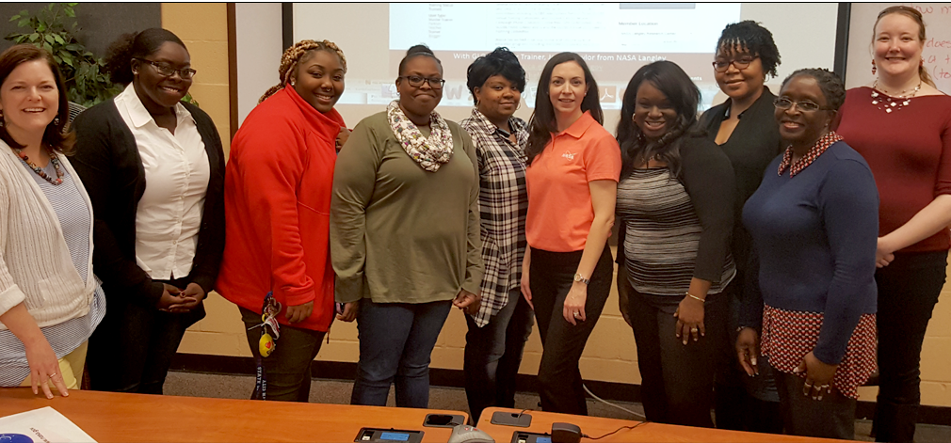
GLOBE Training Part I
Conducted at ECSU with 14 participants and consisted of two sessions
The first session was lead by Dr. Jessica Taylor from NASA-LaRC
3 inservice teachers and 4 preservice students participated in this workshop session

Slide 10
GLOBE Training Part I Curriculum

Slide 11
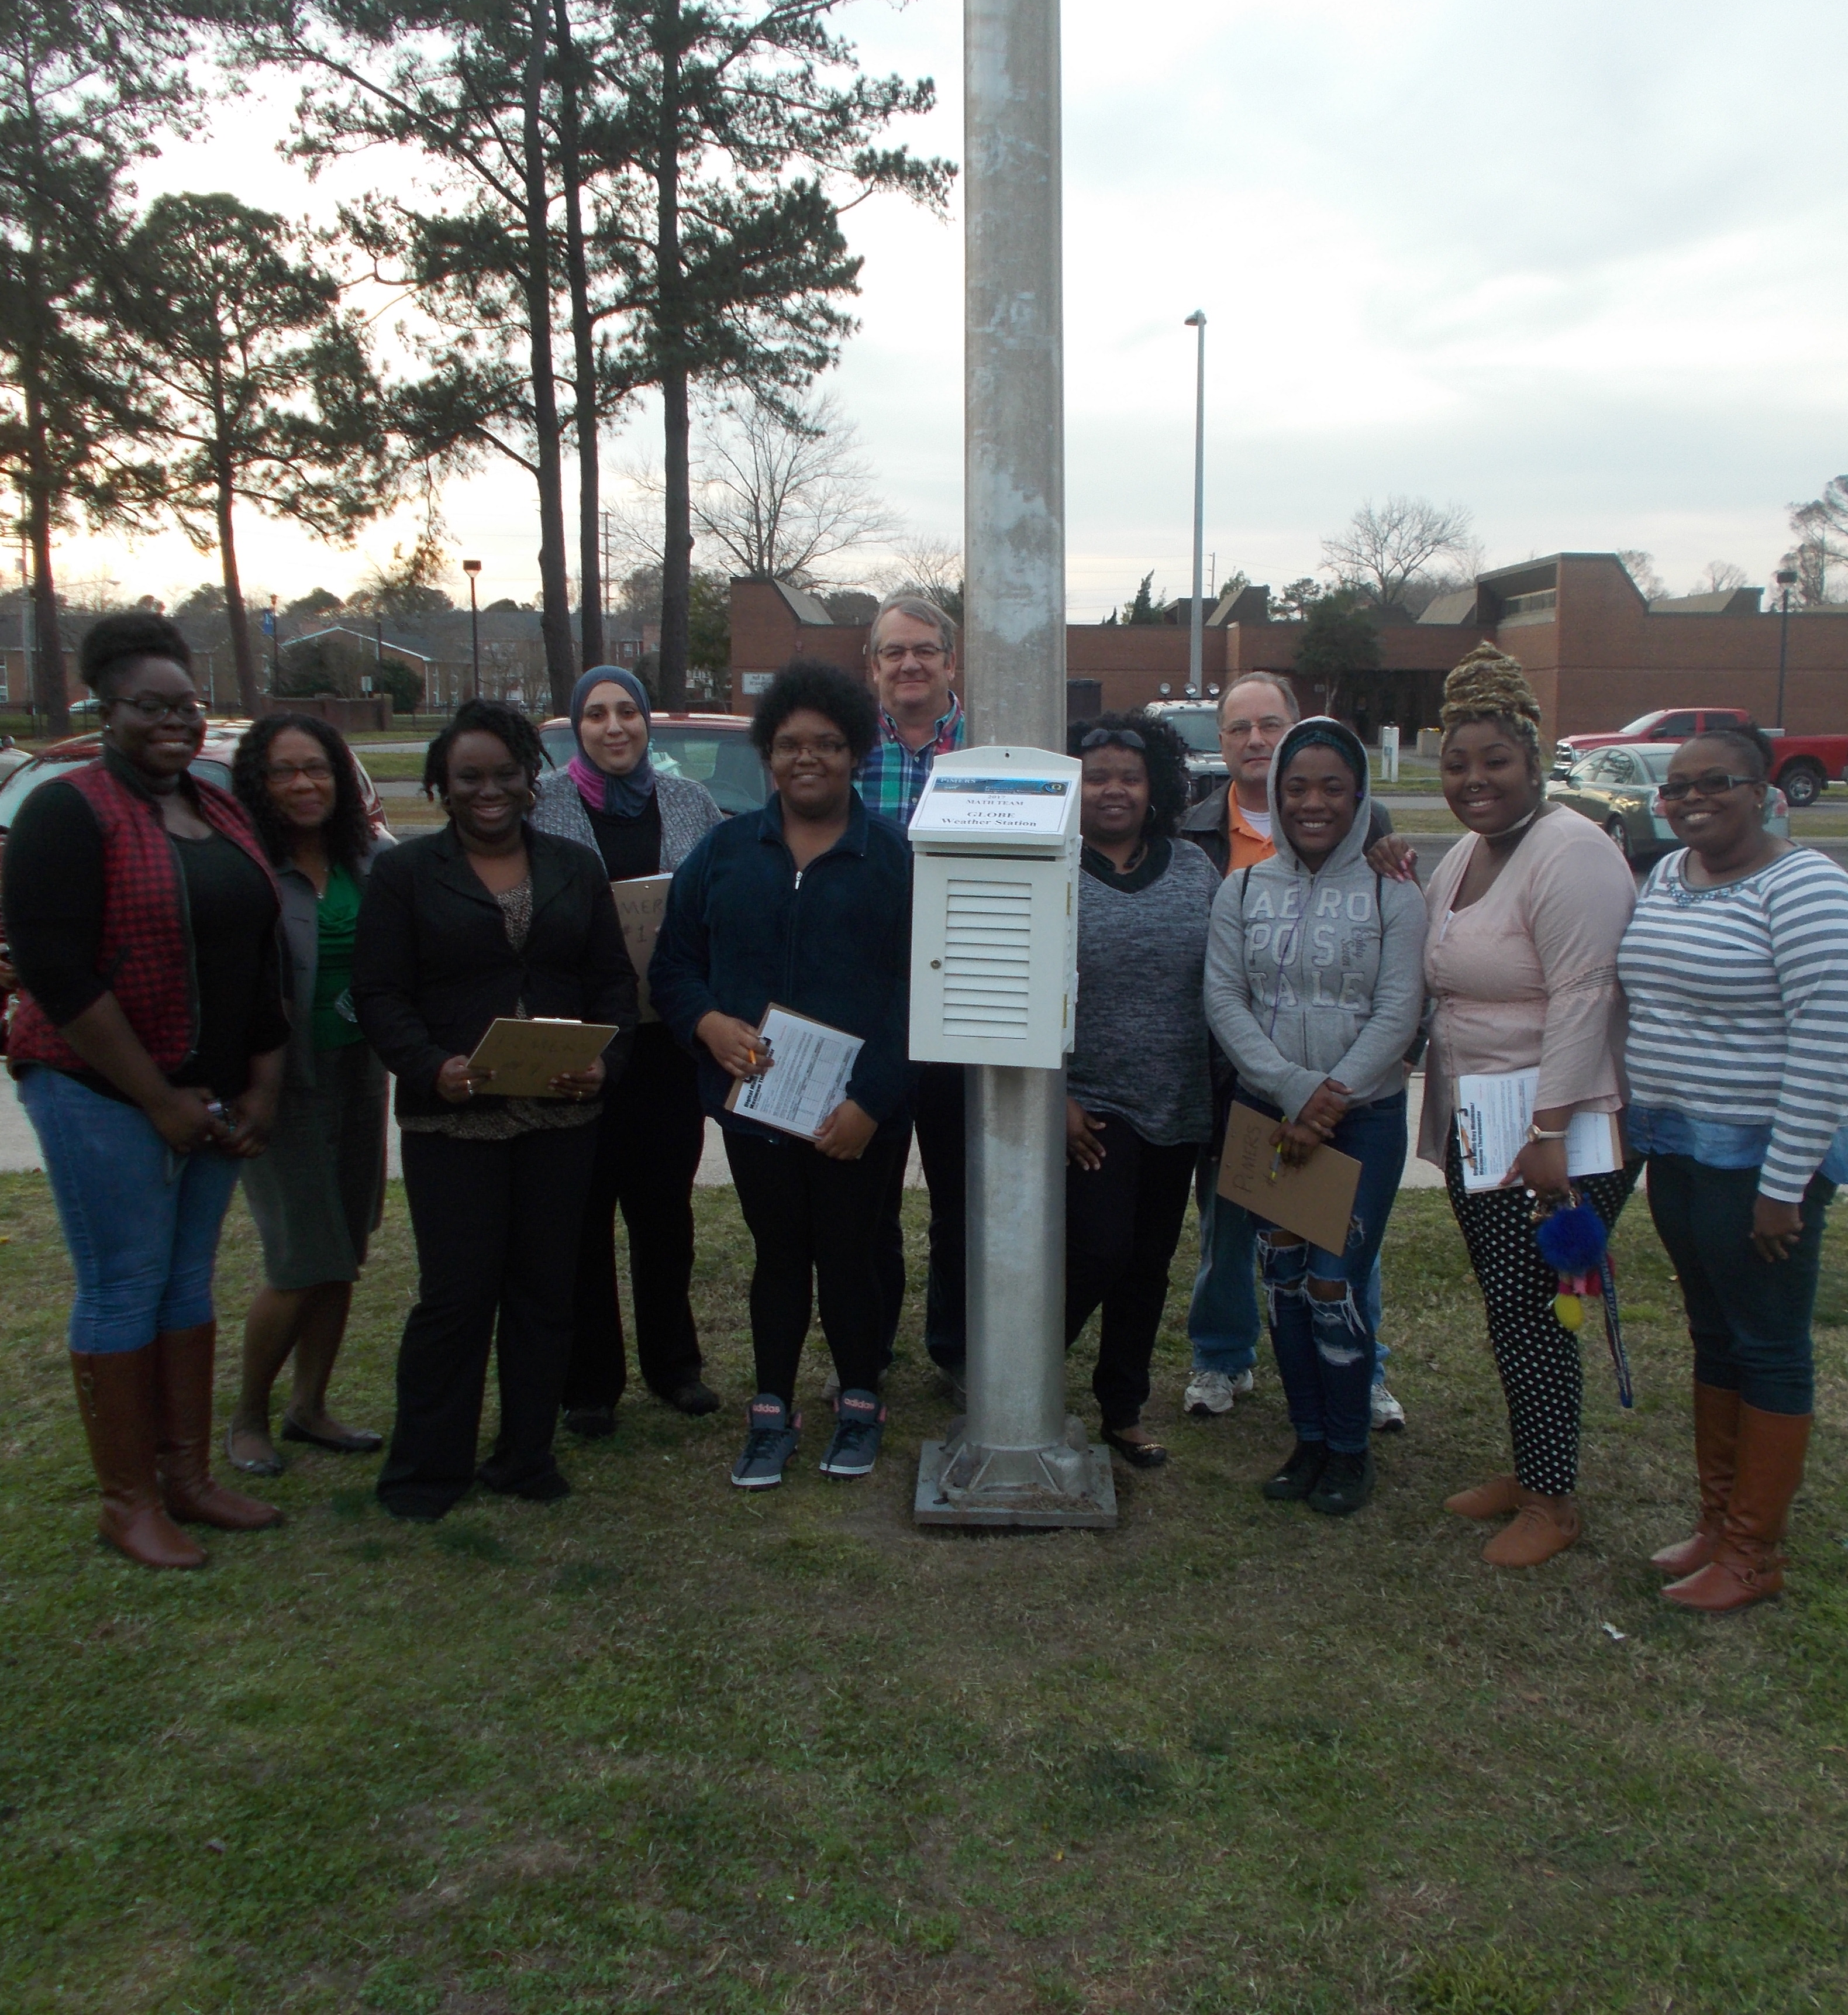
GLOBE Training Part II
A GLOBE certified PiMERS Mathematics Education Team hosted a second session
A total of 6 student and 1 professor participated in this workshop
After becoming GLOBE certified, the PiMERS mathematics education team lead the second session with a group of 7 participants
This group consisted of preservice and ECSU Students

Slide 12
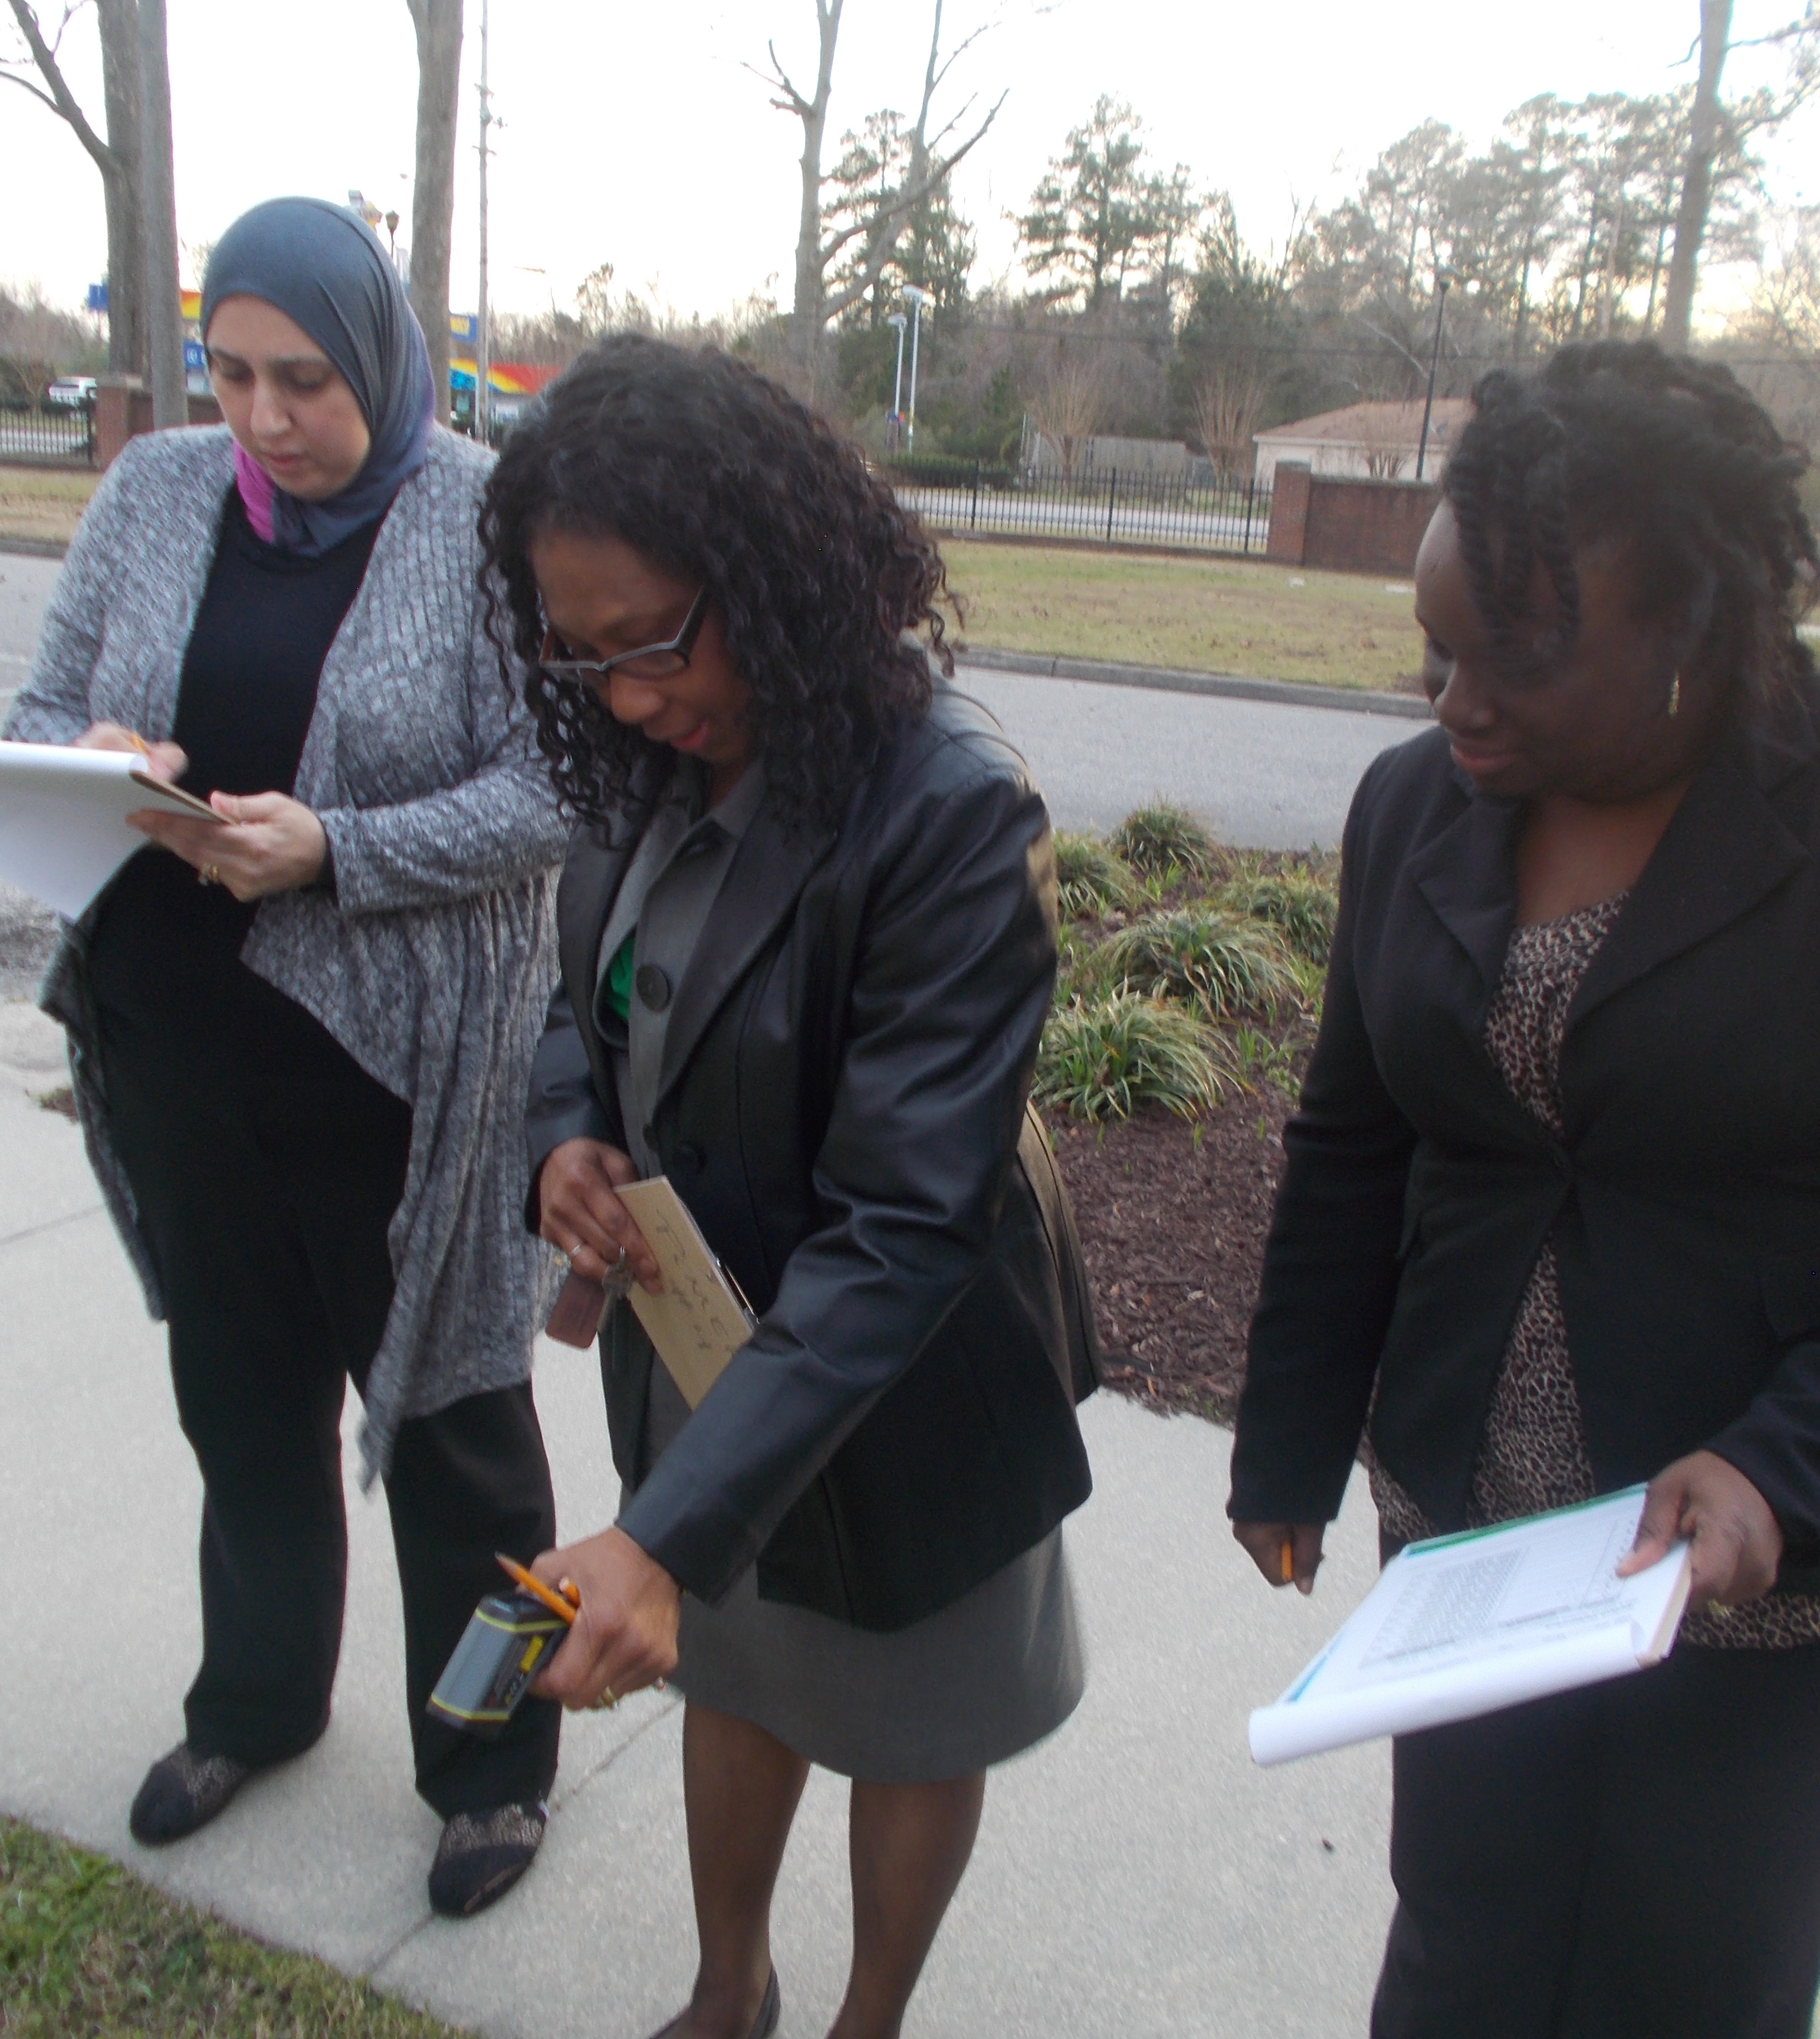
Topics that are associated with GLOBE
Atmosphere
  Air temperature
  Surface temperature
Clouds
  Types of clouds (i.e. high level, mid level)
    Fog
    Nimbostratus
    Cumulonimbus
    Stratus
    Cumulus
    Stratocumulus

Slide 13
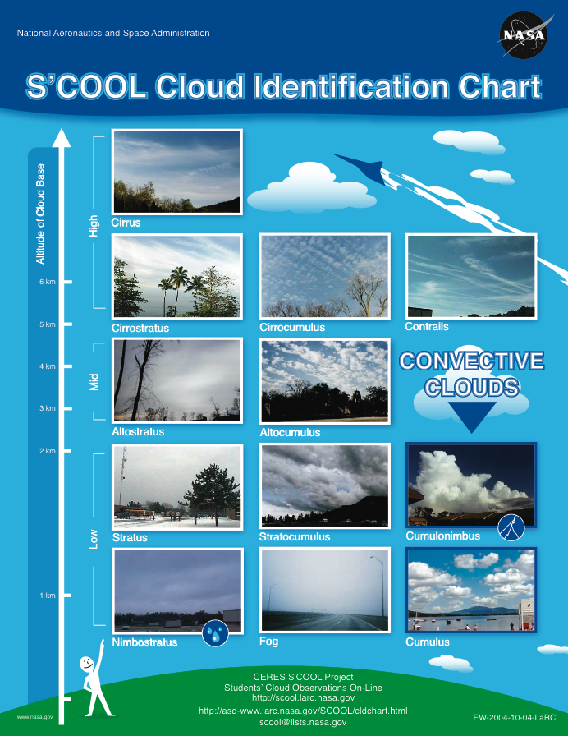
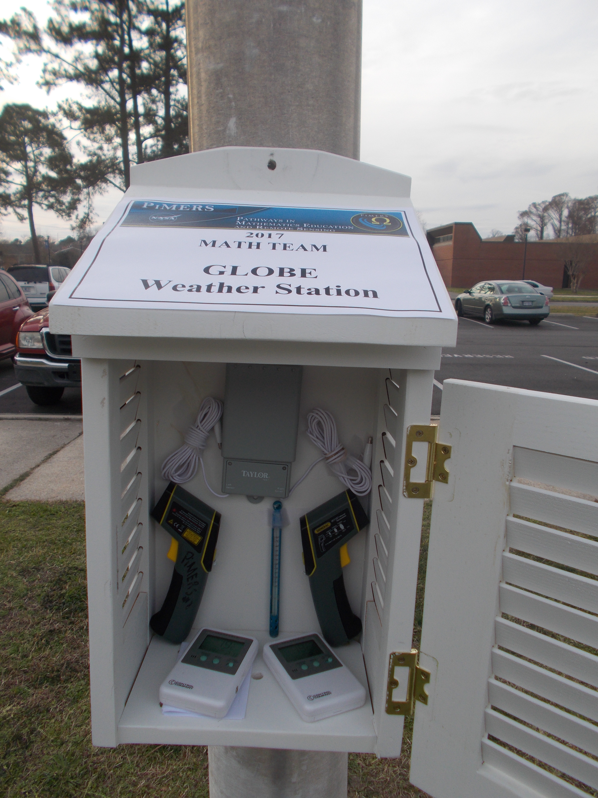
Instruments Used for Each Protocol
Notes:
cloud identification chart for the clouds, a max and min thermometer for the air temperature, and an infrared thermometer for the surface temperature

Slide 14
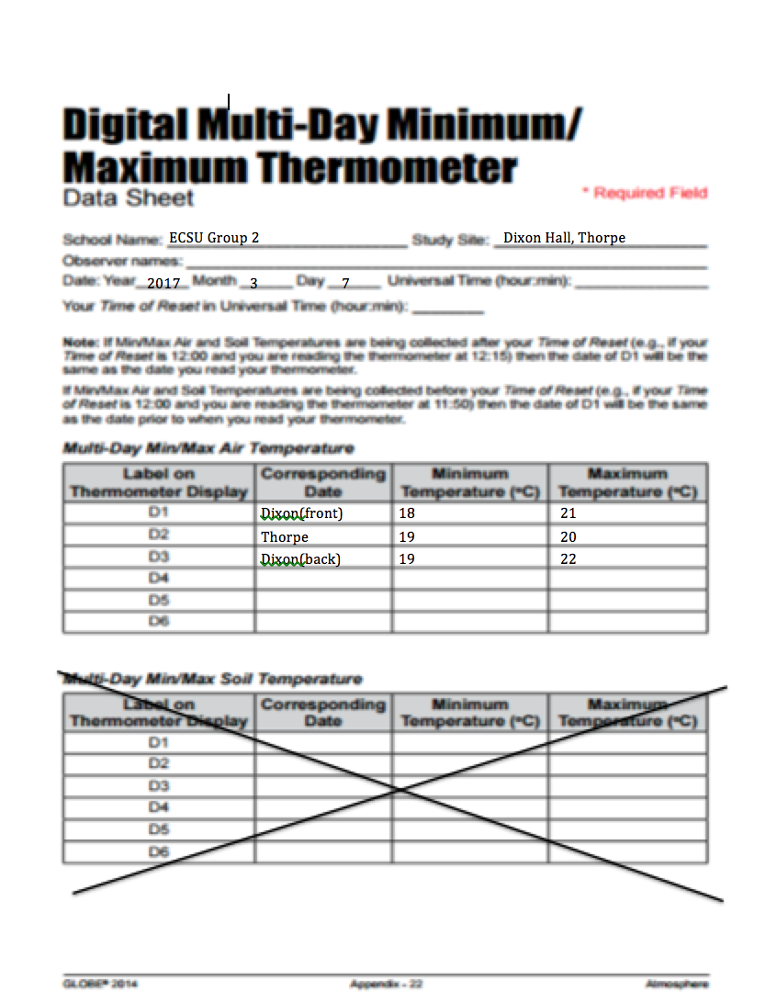
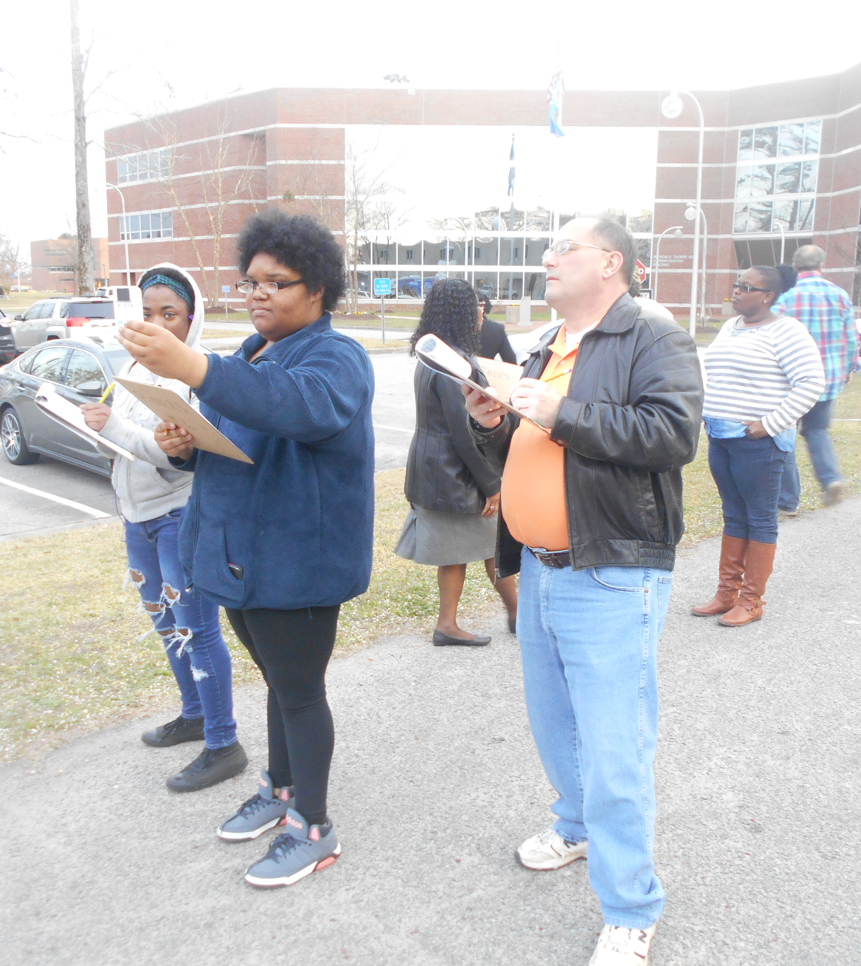
Air Temperature

Slide 15
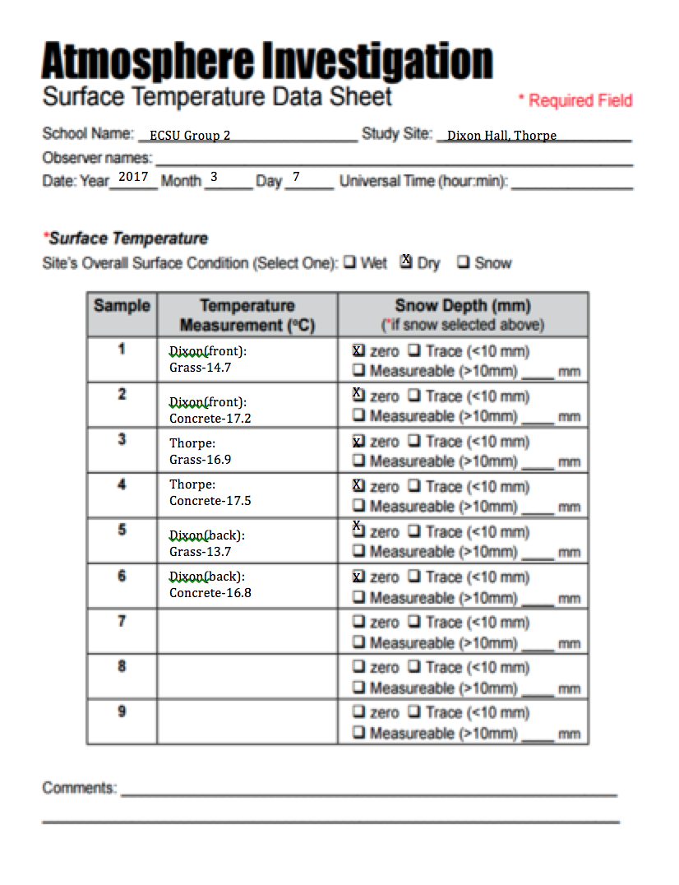
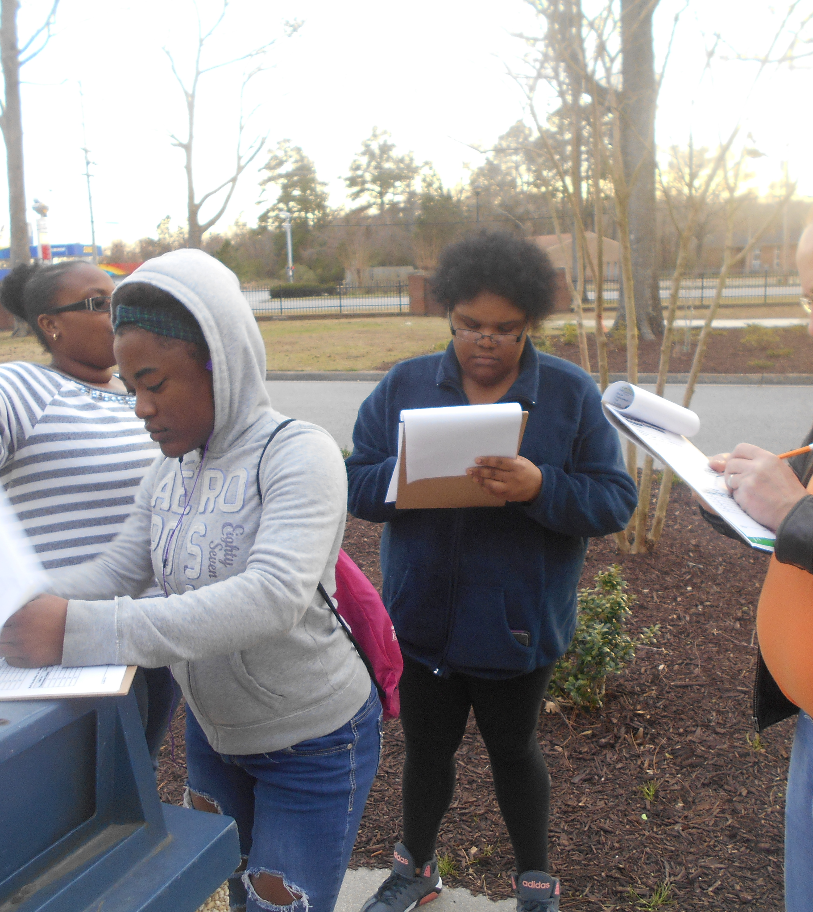
Surface Temperature

Slide 16
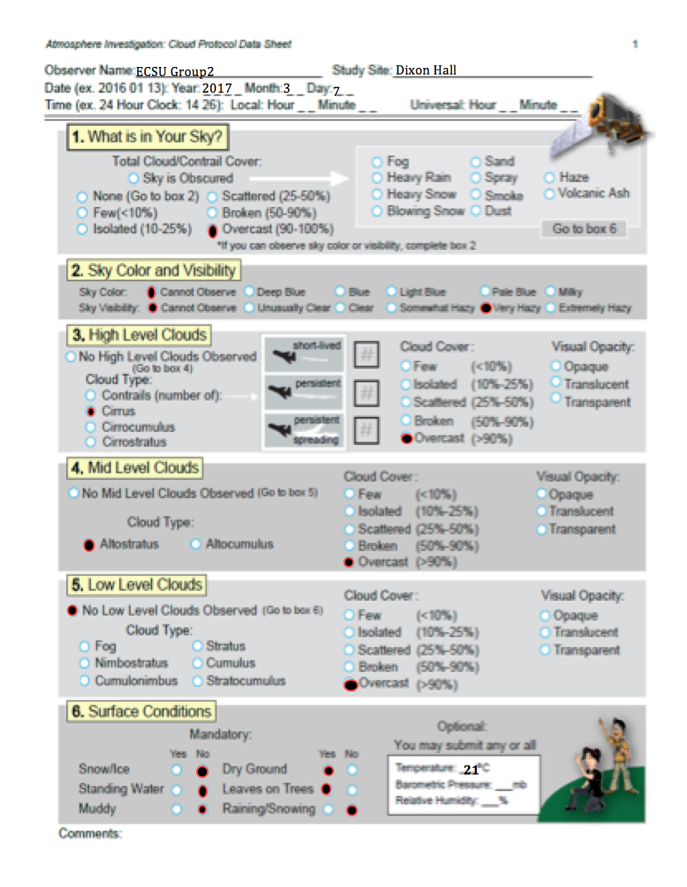
Clouds

Slide 17
GLOBE Survey
The survey was completed by both groups of participants in the February and March workshops.
The survey consisted of a series of 12 questions and was used to gauge what participants experienced from the workshop sessions.
Responses were monitored using a 5 point likert scale from strongly disagree to strongly agree.

Slide 18
GLOBE Survey cont.

Slide 19
Table I
Survey Question | In what role does GLOBE enhance critical thinking?
 | Strongly Disagree/Disagree | Neutral | Strongly Agree/Agree
The learning objectives of the workshop/presentation were clear. | 0 | 0 | 14
The content of the presentation was relevant. | 0 | 0 | 14
The presentation setting was conductive to learning. | 0 | 0 | 14
The presentation facility was clean and comfortable. | 0 | 1 | 13

Slide 20
Chart I

Slide 21
Table II
Survey Question | What are the benefits of GLOBE in the classroom ?
 | Strongly Disagree/Disagree | Neutral | Strongly Agree/Agree
I can apply what I learned from this presentation | 0 | 0 | 14
The use of technology and visual aids made the instruction easier to remember | 0 | 0 | 14
I plan on using information from this session in my classes | 0 | 1 | 13
The session raised my awareness in the STEM field | 0 | 0 | 14

Slide 22
Chart II

Slide 23
Table III
Survey Question | How can preservice and inservice teachers utilize the GLOBE protocols?
 | Strongly Disagree/Disagree | Neutral | Strongly Agree/Agree
The facilitator was knowledgeable on the subject. | 0 | 0 | 14
The facilitator exemplified commitment on the subject. | 0 | 0 | 14
The facilitator kept me interested and attentive. | 0 | 1 | 13
The facilitator seemed prepared and well organized. | 0 | 0 | 14

Slide 24
Chart III

Slide 25

Chi-Square Test
8.31529E-07 | 8.131529E-07 | 8.131529E-07
8.131529E-07 | 8.131529E-07 | 8.131529E-07
8.131529E-07 | 1.34802E-05 | 1.34802E-05
1.34802E-05 | 8.131529E-07 | 8.131529E-07

Slide 26
Conclusion
Participants in the GLOBE workshops and training sessions stated that GLOBE training tended to be beneficial to both preservice students and inservice teachers.
GLOBE is not only for K-12 science classrooms, but for the purpose of educating the global community as well.
This program has a variety of lessons that are flexible enough to be used on all grade levels. The online training aids provided a detailed description of each protocol on the GLOBE website.
Participants of the GLOBE workshops were allowed to conduct research in activities associated with protocols with a positive insight to science, science education, mathematics education, and research techniques.

Slide 27
Future Works
The PiMERS Mathematics Education Team will use a weather station loaned from NASA LaRC to collect data that can be added to the GLOBE database.
The weather station will be placed in a permanent location to conduct continual research.
Annual events such as the PiMERS Middle School summer program, local school division training, and inservice teacher training will be conducted.
The PiMERS Mathematics Team and other researchers will be able to monitor the local environment and observe seasonal or monthly changes.
Presentation this research will be shared to the education department with the recommendation of GLOBE as a part of the curriculum.

Slide 28
Acknowledgments
The 2017 PiMERS Mathematics Education Team would like to thank Dr. Linda B. Hayden, CERSER principal investigator, Dr. Darnell Johnson, research mentor, Dr. Jessica Taylor from NASA-LaRC, and participants form the workshop and training sessions

Slide 29
Questions?

